Slide 1
User-Customizable Movie Recommender System
Somil Bhargava

Slide 2
Motivations for Building a Customizable Movie Recommender System
Existing services don’t give users freedom or control beyond providing ratings
Convey movie recommendations to the general public with their active input
Direct consumer awareness and spending towards products they would appreciate or enjoy
Outside the context of movie recommendations, recommender systems have a high potential impact across a variety of industries
Online retail
Other entertainment (movies, TV, books, video games)
Travel destinations

Slide 3
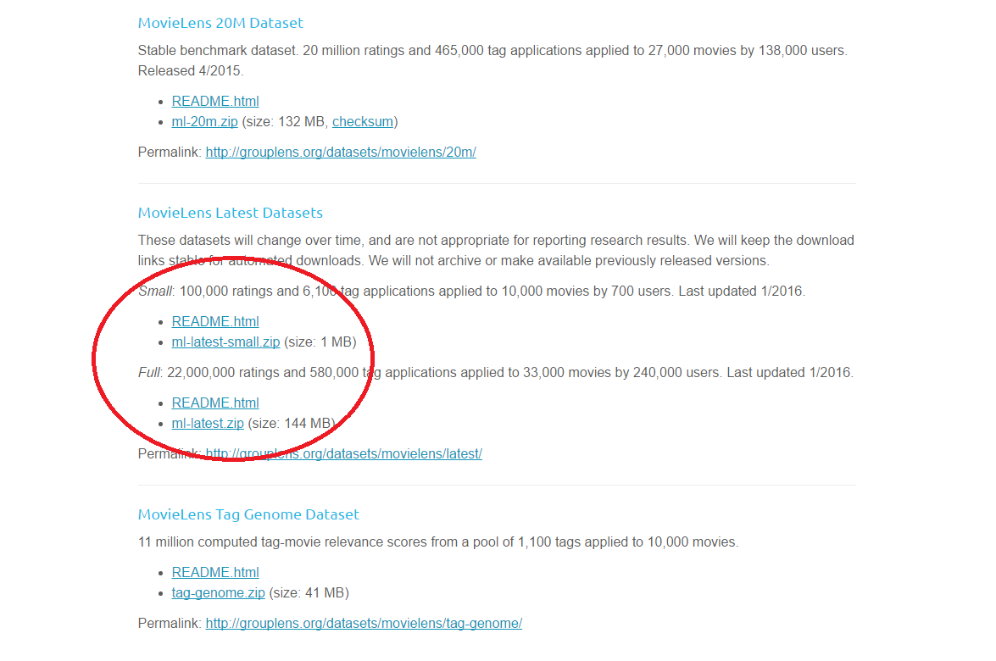
The Data can be found at: http://grouplens.org/datasets/movielens/

Slide 4
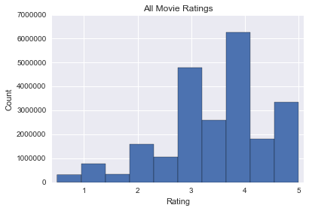
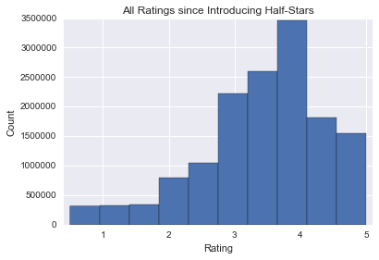
The odd distribution is due to a late implementation of half-star ratings
Half-star ratings were introduced in February 2003
The data collection started in 1995
The recommendation system will require a filter to correct the distribution

Slide 5
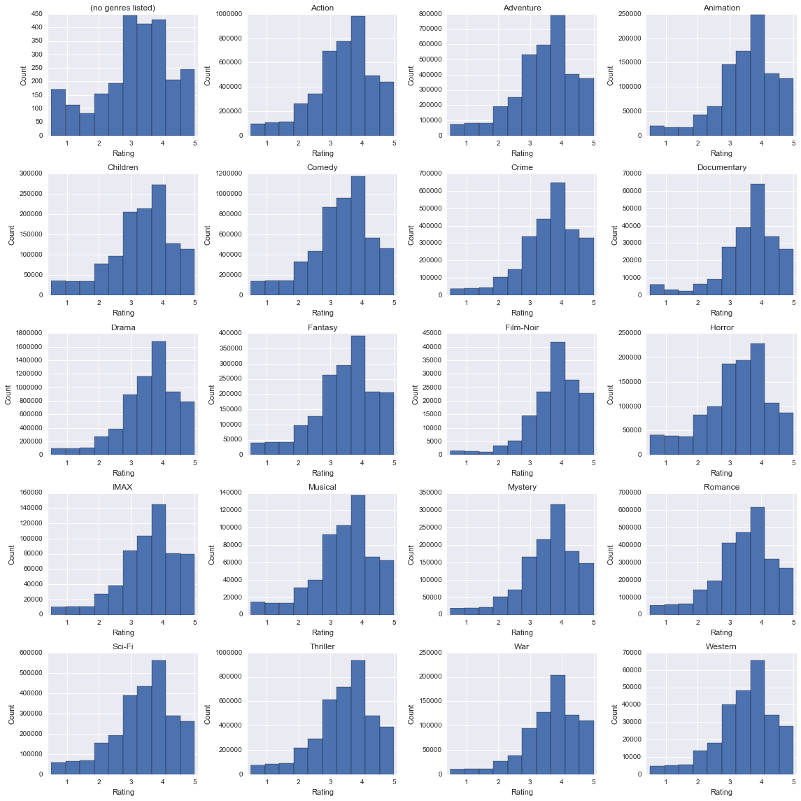
The left-skewed rating distribution persists regardless of movie genre
'(no genres listed)' | 'Action' | 'Adventure' | 'Animation'
'Children' | 'Comedy' | 'Crime' | 'Documentary'
'Drama' | 'Fantasy' | 'Film-Noir' | 'Horror'
'IMAX' | 'Musical' | 'Mystery' | 'Romance'
'Sci-Fi' | 'Thriller' | 'War' | 'Western'
(no genres listed) and IMAX aren’t truly genres because they don’t have anything to do with the story

Slide 6
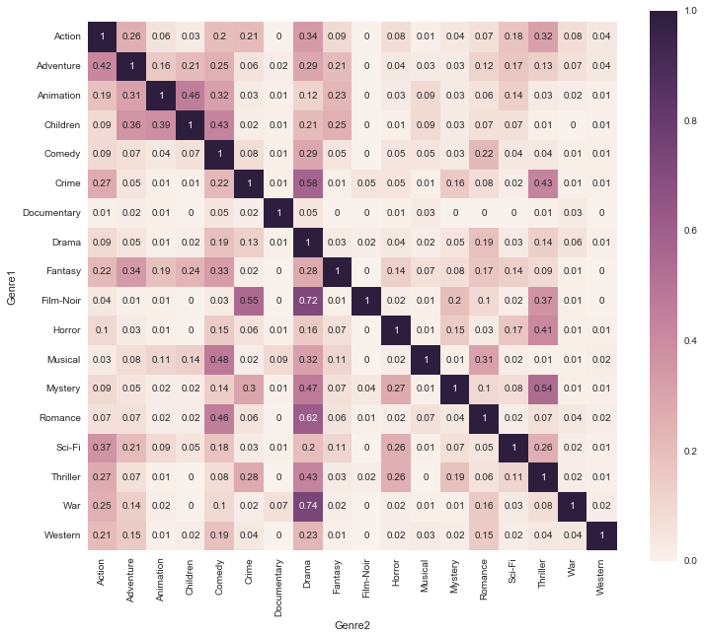
Genre overlap will be used to complement movie recommendations
X% of movies in Genre1 also belong to Genre2
Some genres have a large overlap with others and may contain similar themes
May be useful for refining recommendations
Documentaries have almost no overlap because they are geared towards education rather than entertainment

Slide 7
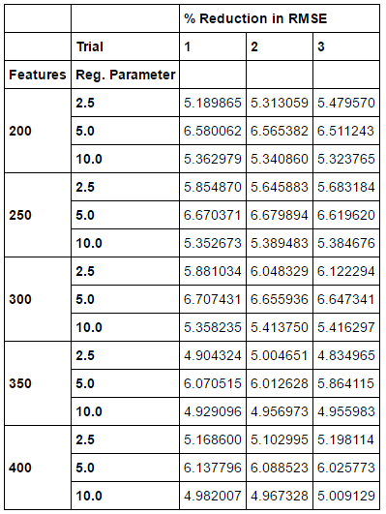
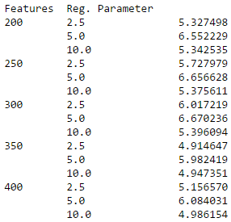

Optimized model reduces RMSE by 7.85% in comparison to predicting the movie’s average rating
Optimization Results
% Reduction in RMSE
on testing partition
Average % Reduction in
RMSE on testing partition

Slide 8
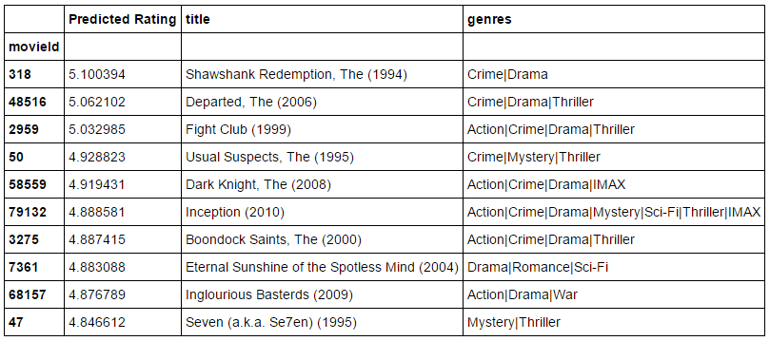
The model can now recommend movies based on ratings a user has supplied

Slide 9
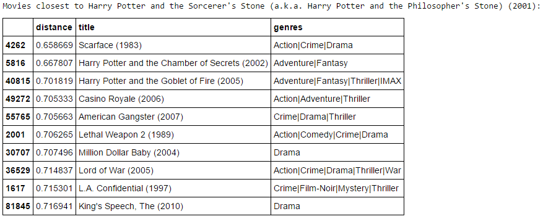
Or, it can recommend movies similar to a target movie

Slide 10
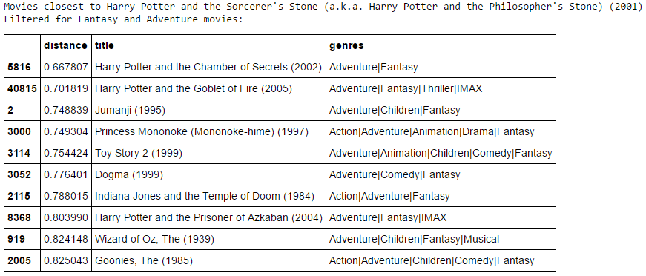
A filter can be applied, removing movies that don’t meet the criteria
Applying a filter may be too steep a penalty
Example: Adding ‘Children’ to the filter removes the other 2 Harry Potter movies

Slide 11
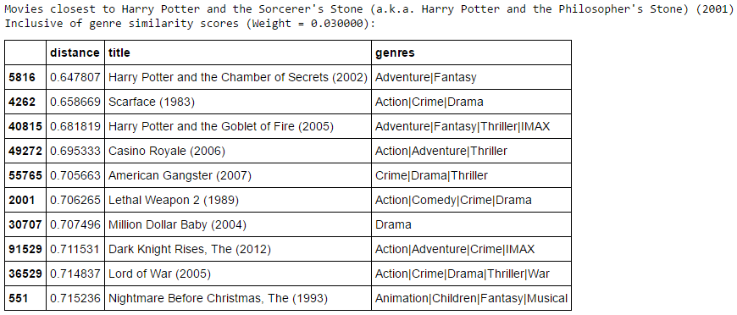
Enhancing recommendations with a genre similarity score may be preferred
Genre similarity score: Percent of target movie’s genres that are also in the other movie’s genres
Genre similarity score is multiplied by a weight constant, then deducted from the distance

Slide 12
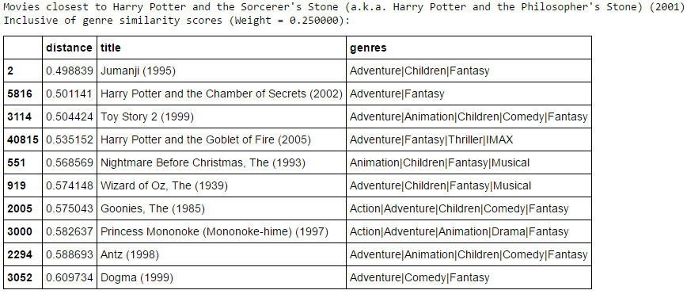
A high weight constant can drastically alter the recommendations
User can change the weight constant to alter how much emphasis is given to the genre similarity score

Slide 13
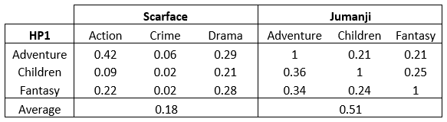

A genre overlap score would be more flexible than the similarity score
Genre similarity assumes no relationship between two different genres
Very strong distance reduction for movies with at least one common genre
Movies without common genres have no change in their distance
Genre overlap assumes a relationship between two different genres
Relationship quantified by genre metadata (heat map, slide 6)

Slide 14
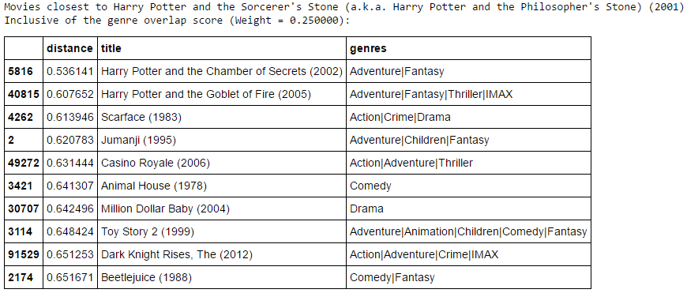
Genre overlap also allows the user to control the emphasis placed on genres

Slide 15
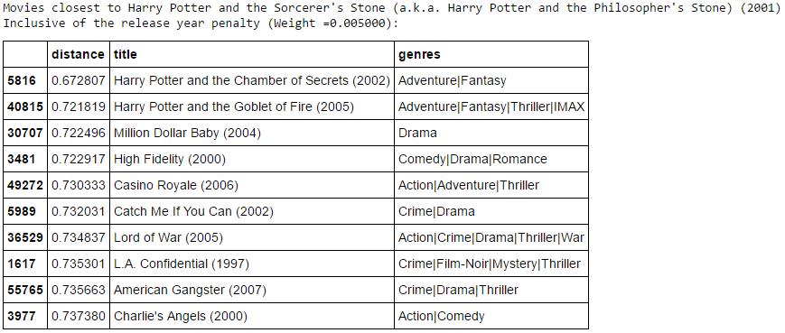
Users may also want to tune their recommendations based on release dates
Absolute difference in release year is multiplied by a weight constant (user controlled) and added to the distance

Slide 16
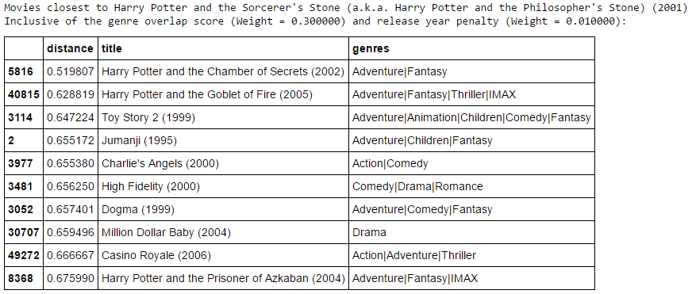
The user has the most control when two of these ideas are implemented together

Slide 17
Precautionary Note
Model reliant on a completely random initialization
Each iteration will have different results
User and movie features may be completely different
Trickles down to determination of distances between movies making it volatile
Predicted ratings stay more consistent across iterations
Pseudo-random initialization would address volatility
Unsuitable for model optimization and reporting performance

Slide 18
Next Steps
Train model using the Full data set rather than the Small data set
Processing power and time constraints made this unviable
Mini-batch and stochastic processes take much longer to optimize and train

